Slide 1
Computer Architecture
Reference:
- Mano, “Computer System Architecture”, Chapter 8
1
Central Processing Unit Architecture
  Design Approaches [Stack – Pipelining – Interrupt – Processor Organization – Registers Organization]
  Instruction Set Architecture [Instruction Format – Addressing modes – Data Transfer and Manipulation]
  Example architectures (e.g. CISC, RISC)
Timing, Clock Parameters, and Processor Performance
Memory Hierarchy
  Main Memory
  Cache Memory
  Virtual Memory
IOs and memory interfacing
Hardware Description Languages (VHDL) in Lab.
Computer Architecture Module
Content
2

Slide 2


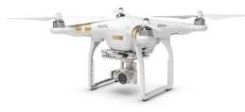

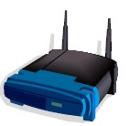
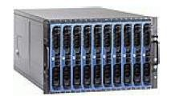



Computer Architecture Module
Assessment
In-class test
Lab exam /Project
Unseen Exam
20%
20%
60%
3
Computing Devices now
2

Slide 3
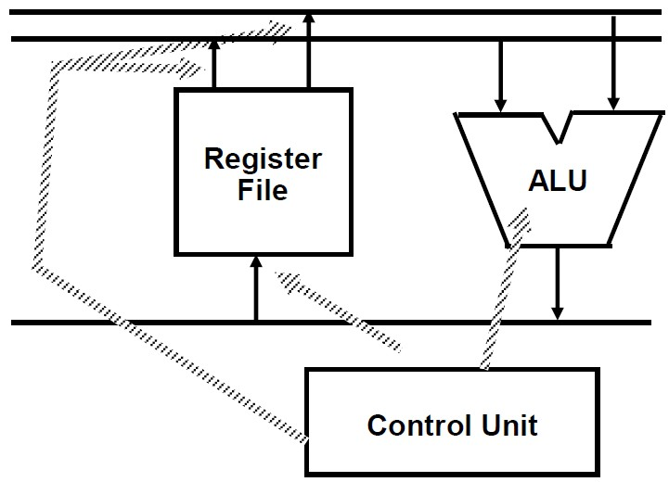
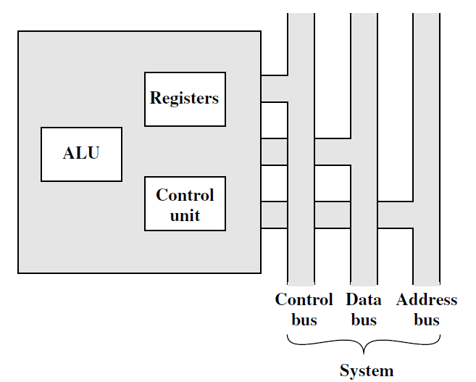
CPU Architecture: Key Components
Execution (Processing) Components
Arithmetic Logic Unit(ALU)
  Arithmetic calculations, Logical computations, Shifts/Rotates
Storage Components
Registers
Flags
Control Components
Control Unit
Transfer Components
Bus
5
CPU with System Bus
6
Notes:
What is a CPU?
Execution of instructions provided by computer programs is the responsibility of the central processing unit (CPU), which is frequently referred to as the brain of a computer. In addition to doing mathematical computations and interpreting these instructions, it is also responsible for controlling the flow of data to the various components of the computer system. When it comes down to it, the central processing unit (CPU) is the one that makes decisions and coordinates the activities that are necessary to finish processes such as running software, producing images, or interfacing with peripherals.
This architecture of a central processing unit (CPU) determines how it executes these instructions and how it interacts with other components of the hardware, such as memory, storage devices, and input/output systems. The central processing units (CPUs) of today are incredibly powerful and come equipped with a number of advanced features that increase performance. These characteristics include cache memory, numerous cores, and high clock speeds.
The Main Components of a CPU
A CPU is not just a single unit, but a complex structure made up of several smaller components that work together to execute tasks. The primary components of a CPU include the Control Unit (CU), the Arithmetic and Logic Unit (ALU), registers, cache memory, and the clock. Each of these parts plays a crucial role in ensuring that the CPU can efficiently carry out its operations.
Control Unit (CU)
The Control Unit is responsible for directing the entire CPU's operations. It coordinates the flow of data between the CPU’s various components and other parts of the computer system. The CU tells the Arithmetic and Logic Unit (ALU) what operation to perform, manages data flow between registers, and communicates with memory and I/O devices.
When a program is running, the CU fetches instructions from the memory, decodes them to understand what action needs to be taken, and then executes those actions step by step. It generates control signals that guide the operation of the entire CPU.
Arithmetic and Logic Unit (ALU)
The Arithmetic and Logic Unit (ALU) is where the actual computation happens. It performs all the arithmetic operations, such as addition, subtraction, multiplication, and division. It also handles logical operations like AND, OR, NOT, and comparison operations (e.g., greater than, less than, equal to). The ALU is essential for any kind of mathematical processing, data manipulation, or decision-making that the CPU needs to perform.
In modern processors, there may also be a specialized Floating Point Unit (FPU), which handles complex mathematical operations involving floating-point numbers (real numbers with decimals), like scientific calculations or 3D graphics rendering.
Registers
Registers are small, fast storage locations inside the CPU that hold data temporarily while it is being processed. Registers are crucial because they provide rapid access to data compared to accessing the main memory (RAM), which is slower. There are different types of registers with specific functions, such as the Program Counter (PC), Instruction Register (IR), Accumulator, and Status Registers.
The Program Counter (PC) holds the address of the next instruction to be fetched from memory, while the Instruction Register (IR) holds the current instruction being executed. Status registers store condition flags (e.g., zero, carry, overflow) that indicate the results of operations, which are important for branching decisions in a program.
Cache Memory
Cache memory is a small, ultra-fast memory located close to the CPU, designed to store frequently accessed data and instructions. Cache helps to speed up processing by reducing the time the CPU needs to fetch data from the slower main memory. There are typically multiple levels of cache: L1 cache, L2 cache, and sometimes L3 cache.
L1 cache is the smallest and fastest, located closest to the CPU cores. It holds the most frequently accessed data and instructions. L2 cache is larger but slightly slower and may be shared by multiple cores. L3 cache, which is often shared among all cores in multi-core processors, is the largest but the slowest.
Clock and Timing
The clock is a critical component that synchronizes all of the CPU's operations. It generates regular electrical pulses, known as clock cycles, which act as a timing mechanism to ensure that instructions are executed in the correct order. Each clock cycle is like a heartbeat for the CPU, and the speed at which it ticks is known as the clock speed, typically measured in gigahertz (GHz). Higher clock speeds generally result in faster processing, although other factors like the architecture and number of cores also influence performance.

Slide 4
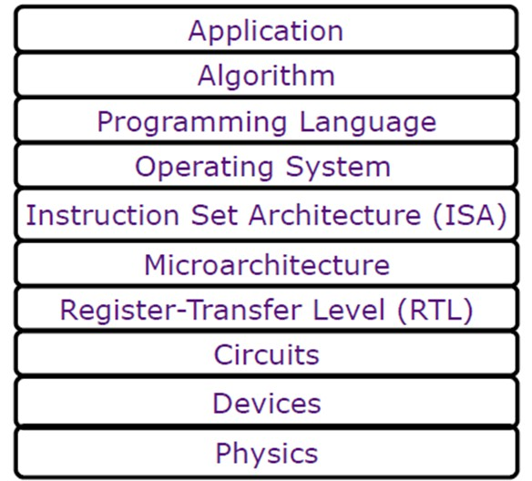
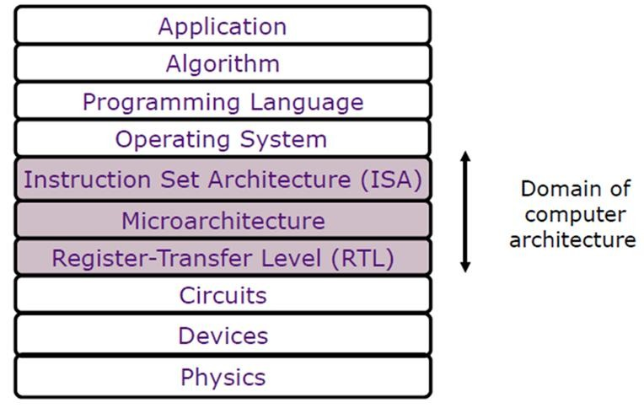
Abstraction layers
7
Abstraction layers
6

Slide 5
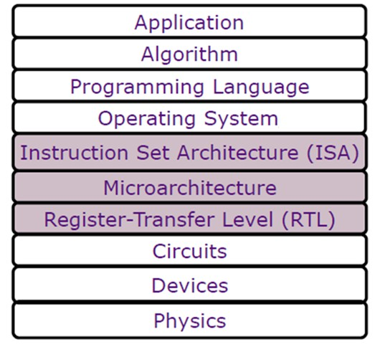
Abstraction layers
ISA: definition between software and hardware
RTL: Hardware
Microarchitecture: Microoperations
9
Instruction Set Architecture (ISA)
ISA is the hardware/software interface
  Define the instruction set: all the instructions a processor can execute
  Defines the set of programmer visible state
  Defines data types
  Defines instruction semantics (operations, sequencing)
  Defines instruction format (bit encoding)
ISA must satisfy the needs of the software: assembler, compiler, OS
10
5
Notes:
Your description summarizes the key aspects of an Instruction Set Architecture (ISA). Here’s a more structured breakdown of the components you mentioned:
Instruction Set Architecture (ISA)
Definition:
The ISA serves as the interface between hardware and software, providing a set of instructions that the processor can execute.
Components:
Instruction Set:
All the instructions a processor can execute, which defines the capabilities and operations available.
Programmer Visible State:
The elements of the processor's state that can be accessed and manipulated by the programmer. This includes registers, flags, and memory configurations.
Data Types:
The basic data types that the ISA supports (e.g., integers, floating-point numbers, characters), which are critical for defining how data is processed and stored.
Instruction Semantics:
Operations: The functions that the instructions perform (e.g., addition, subtraction, data transfer).
Sequencing: The order in which instructions are executed, which can affect the program flow.
Instruction Format:
The structure of each instruction, including:
Bit Encoding: How different fields (such as opcode, operands) are represented in binary form.
Summary
The ISA is crucial for ensuring that software can effectively utilize the underlying hardware, providing a clear and consistent set of rules and structures for programming. It defines both how instructions are executed and the data types that can be used, making it fundamental to computer architecture.

Slide 6
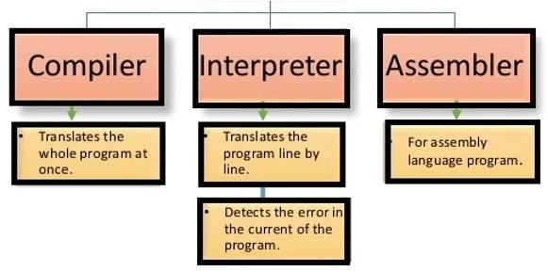
Translators
11
Translators
Assembler
Assembler: a computer program that translates assembly language to an object file or machine language format.
Compiler
A compiler is a computer program (or a set of programs) that transforms source code written in a programming language into a binary form known as object code.
It takes time to execute a program because it first translates the source code into another compiler’s language and then using an assembler converts it into machine language.
13
6

Slide 7
Translators
Interpreter
The Interpreter translates the program written in a high-level language into machine language, instructions by instructions.
It reads the first instruction written in the program and converts it into equivalent machine language instructions. Then the CPU executes those machine language instructions. After that, the interpreter reads and translates the next instruction, and so on.
When any statement is changed in the source code and the program is recompiled, the interpreter is faster than the compiler.
14
Computer Architecture Module
Content
Central Processing Unit Architecture
  Design Approaches [Stack – Pipelining – Interrupt – Processor Organization –
Registers Organization]
  Instruction Set Architecture [Instruction Format – Addressing modes – Data Transfer and Manipulation]
  Example architectures (e.g. CISC, RISC)
Timing, Clock Parameters, and Processor Performance
Memory Hierarchy
  Main Memory
  Cache Memory
  Virtual Memory
IOs and memory interfacing
Hardware Description Languages (VHDL) in Lab.
15

Slide 8
Feature | Assembler | Compiler | Interpreter
Definition | Converts assembly language into machine code. | Transforms source code into binary form (object code). | Translates high-level language to machine code, instruction by instruction.
Functionality | 1:1 translation of instructions. | Processes entire code in multiple phases. | Executes code line by line.
Execution | Generate object code before execution. | Generates executable code before running. | Executes instructions immediately.
Speed | Fast translation; efficient execution. | Fast execution after initial compilation; slower during initial compilation. | Slower execution; faster for development/testing.
Use Cases | Systems programming, embedded systems. | Software development, large applications, games. | Scripting, web development, educational use.
Advantages | Optimizes code for specific hardware; efficient. | Produces fast executables; can optimize code. | Immediate execution; quick debugging.
Drawbacks | Hardware-specific; requires detailed architecture knowledge. | Longer compilation time; harder debugging due to late error detection. | Less efficient for large programs; real-time translation overhead.
Error Handling | Usually shows errors related to syntax. | Displays errors after complete compilation. | Catches and reports errors during execution.
Notes:
Assembler
Function:
Converts assembly language (a low-level programming language) directly into machine code (binary format that the CPU understands).
Each assembly language instruction corresponds closely to machine language instructions, making the translation straightforward.
Use Cases:
Often used in systems programming, embedded systems, and performance-critical applications due to its proximity to machine hardware.
Advantages:
Allows programmers to write code that can be optimized for specific hardware.
Generally results in very efficient object code.
Drawbacks:
Assembly language is hardware-specific, making translation less portable across different systems.
Requires detailed knowledge of computer architecture.
Compiler
Function:
Performs several steps to convert high-level programming languages (like C, C++, or Java) into object code:
Lexical Analysis: Breaks the source code into tokens.
Syntax Analysis: Ensures the code conforms to the grammar of the programming language.
Semantic Analysis: Checks for semantic errors, ensuring the code makes logical sense.
Optimization: Improves the code for performance (optional).
Code Generation: Produces object code.
Use Cases:
Used for software development where execution speed and performance are crucial, such as system applications, desktop software, and games.
Advantages:
Produces fast executable programs since the translation occurs before execution.
Can optimize code for better performance.
Drawbacks:
Longer initial compilation time can slow down development, especially during frequent changes.
Debugging can be harder since errors may not be caught until the entire program is compiled and executed.
Interpreter
Function:
Translates high-level programming languages into machine code one instruction at a time, executing each instruction immediately after translation.
Use Cases:
Commonly used in scripting languages (like Python, Ruby, and JavaScript), web development, and educational environments where ease of use and rapid feedback are essential.
Advantages:
Immediate execution of code allows for quick testing and debugging.
Easier to work with during development, as changes can be tested without needing full recompilation.
Drawbacks:
Generally slower than compiled code due to real-time translation.
Inefficient for running larger programs or applications, as the overhead of translation adds up.
Summary of Differences
Execution Method:
Assembler: One-to-one translation of instructions into machine code.
Compiler: Translates the entire program before execution.
Interpreter: Translates and executes one instruction at a time.
Speed:
Compilers: Faster execution after compilation.
Interpreters: Slower due to real-time translation, but faster for iterative development.
Error Handling:
Compilers: Errors are reported after the entire code is compiled.
Interpreters: Errors are caught and reported as each line is executed.
These distinctions highlight how each tool fits into different areas of programming and software development, providing unique benefits based on the specific needs of a project. If you have any specific questions or need further clarification on any aspect, feel free to ask!

Slide 9
Registers
16
User-visible registers
Control and status registers
17
Registers Types

Slide 10
Processor Registers
User-visible registers
  General Purpose Registers
  Data Registers (for integers, fixed-point, or floating-point numbers)
  Address Registers (for address, index, stack pointer, or segment pointer)
  Condition Codes Registers
Control and status registers
  Control word that contains the MUXs and Decoder selection bits in the CPU architecture.
  Status Registers, Called also Program Status Word (PSW)
There is not a clean separation of registers into these two categories. However, we will use these
categories in the following discussion.
18
User-visible Registers
General purpose registers: used to store temporary data during any ongoing operation.
Data registers: hold data and can’t be employed in calculating an operand address.
Condition codes (flags)
  Condition codes are bits the processor hardware sets as the result of operations. For example, an arithmetic operation may produce a positive, negative, zero, or overflow result.
  Usually, they form part of a control register. Generally, machine instructions allow these bits to be read by implicit reference, but the programmer cannot alter them.
19

Slide 11
Control Registers
Processor registers that are employed to control the operation of the processor and are not visible to the user.
Some of them may be visible to machine instructions executed in a control or operating system mode.
Each machine has a different register organization and uses different terminology.
20
Status Registers
Four registers are essential to instruction execution:
  Program counter (PC): Contains the address of an instruction to be fetched.
  Instruction register (IR): Contains the instruction most recently fetched.
  Memory address register (MAR): Contains the address of a location in memory.
  Memory buffer register (MBR): Contains a word of data to be written to memory or the word most recently read.
21

Slide 12
Status Registers
Many processor designs include a register or set of registers, often known as the program status word (PSW), that contain status information. The PSW typically contains condition codes plus other status information.
Common flags include the following:
  Sign: Contains the sign bit of the result of the last arithmetic operation.
  Zero: Set when the result is 0.
  Carry: Set if an operation resulted in a carry (addition) into or borrow (subtraction) out of a high-order bit. Used for multiword arithmetic operations.
  Equal: Set if the logical compare result is equality.
  Overflow: Used to indicate arithmetic overflow.
  Interrupt Enable/Disable: Used to enable or disable interrupts.
23

Slide 13
Register Type | Description
General Purpose Registers | Registers that can store data, addresses, or instructions. They are versatile and often used for various operations.
Data Registers | Specifically designed to hold data values. This includes:
 | - Integer Registers: Store integer values.
 | - Fixed-Point Registers: Hold fixed-point numbers for precise arithmetic without floating-point complexity.
 | - Floating-Point Registers: Designed to hold floating-point numbers for handling real numbers and decimal values.
Address Registers | Used to store memory addresses or pointers. This includes:
 | - Index Registers: Often used for loop counting and array indexing.
 | - Stack Pointer Registers: Point to the current top of the stack in memory.
 | - Segment Pointer Registers: Used in segmented memory architectures to point to segments of memory.
Condition Codes Registers | Hold flags that indicate the status of the CPU or the outcome of arithmetic and logical operations (e.g., zero, carry, overflow).
Control and Status Registers | Registers that control various CPU operations and status reporting. This includes:
 | - Control Word: Contains bits that configure MUXs (multiplexers) and decoders within the CPU architecture.
Status Registers (PSW) | Also known as the Program Status Word, this register encapsulates the current status of the processor, including conditions, interrupt enable bits, and other control flags.
Notes:
Additional Notes
Overlapping Functions: It's important to note that registers can often serve multiple purposes, and the distinction between categories may not always be clear-cut. For example, some general-purpose registers could also function as data or address registers, depending on the context.
Usage Variability: The use of specific registers may vary depending on the architecture of the CPU (e.g., x86, ARM, MIPS), leading to variations in naming and functionality.
If you need more details on any specific register or category, feel free to ask!

Slide 14
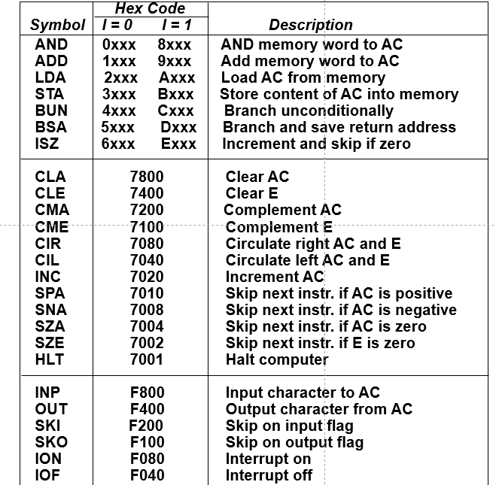
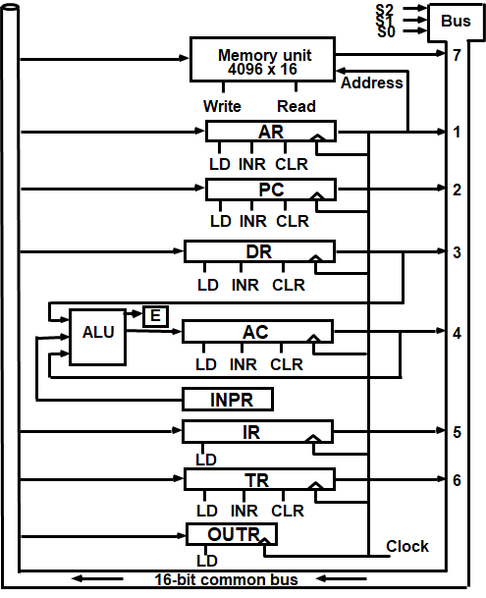
Mano’s Basic-Computer
(Single Accumulator Organization)
Mano’s Basic-Computer
(Single Accumulator Organization)
21

Slide 15
Mano’s Basic-Computer
Instruction Register (IR)
15 14 13 12 11 – 0
Other inputs
3 x 8 Decoder
7 6 5 4 3 2 1 0
I
D ₀
D ₇
Combinational Control
logic
Control signals
T15 T₀
15 14 . . . . 2 1 0
4 x 16 Decoder
4-bit
Sequence Counter (SC)
Increment (INR) Clear (CLR) Clock
25
Registers
In Basic Computer, there is only one general purpose register, the Accumulator (AC)
In modern CPUs, there are many general purpose registers
  Transfer between registers within the processor is relatively fast
  Going “off the processor” to access memory is much slower
26

Slide 16
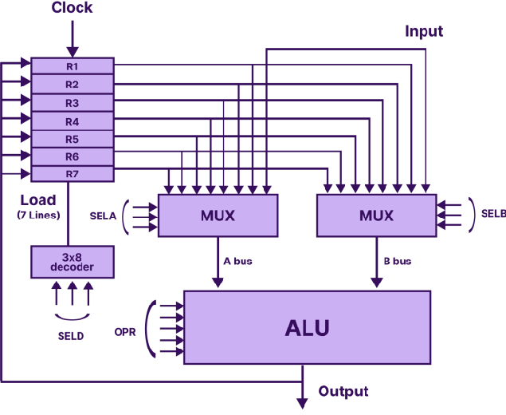
General Register Organization
Control word size and parts ???
27
Bus System
Example: IBM 360 Machine
Processor State
  16 General-Purpose 32-bit Registers
  4 Floating Point 64-bit Registers
  A Program Status Word (PSW) : PC, Condition codes, Control flags
  512 KB x 64-bit memory [16 MB byte-addressable memory space]
Data Formats
  8-bit (bytes), 16-bit (half-words), 32-bit (words), 64-bit (double-words)
  24-bit addresses
29

Slide 17
Example:
Types of Registers in 8086 Microprocessor ???
Types of Registers in RISC-V ???
Types of Registers in core i7 intel processor ???
30
In RISC processors
31
Overlapped Register Windows Organization

Slide 18
Overlapped Register Windows
A procedure call produces a sequence of instructions that save register values, pass parameters needed for the procedure, and then calls a subroutine to execute the body of the procedure.
After a procedure return, the program restores the old register values, passes results to the calling program, and returns from the subroutine.
Saving and restoring registers and passing of parameters and results involve time- consuming operations.
  Some computers provide multiple-register banks, and each procedure is allocated its own bank of registers. This eliminates the need for saving and restoring register values.
  Some computers use the memory stack to store the parameters that are needed by the procedure, but this requires a memory access every time the stack is accessed.
Overlapped Register Windows
A characteristic of some RISC processors is their use of overlapped register windows to provide the passing of parameters and avoid the need for saving and restoring register values.
Each procedure call results in the allocation of a new window consisting of a set of registers from the register file for use by the new procedure.
Each procedure call activates a new register window by incrementing a pointer, while the return statement decrements the pointer and causes the activation of the previous window.
Windows for adjacent procedures have overlapping registers that are shared to provide the passing of parameters and results.

Slide 19
Feature | Description
Concept | Overlapped register windows allow multiple procedures to share registers, minimizing the need to save and restore register values during procedure calls.
Procedure Call Process | 1. Save Register Values: Typically, a procedure call saves current register values.
 | 2. Pass Parameters: Parameters needed for the procedure are passed.
 | 3. Subroutine Execution: The subroutine executes using its allocated registers.
 | 4. Return: After completing execution, results are passed back, and old register values are restored.
Challenges Addressed | - Saving and restoring registers can be time-consuming.
 | - Using the memory stack for parameter storage incurs additional memory accesses, leading to inefficiencies.
Implementation | - In systems with overlapped register windows, each procedure is allocated its own set of registers from the register file.
 | - A pointer is used to manage the current window:
 | - Pointer Increment: Activates a new window for a new procedure call.
 | - Pointer Decrement: Activates the previous window upon return.
Shared Registers | - Adjacent procedure windows share overlapping registers, allowing for efficient parameter passing and result retrieval.
Architecture Impact | - Common in RISC (Reduced Instruction Set Computer) architectures, promoting efficient procedure call handling.
Notes:
Here's an overview of overlapped register windows, including their purpose, functionality, and advantages in a structured format:
Overlapped Register Windows
FeatureDescriptionConceptOverlapped register windows allow multiple procedures to share registers, minimizing the need to save and restore register values during procedure calls.Procedure Call Process1. Save Register Values: Typically, a procedure call saves current register values.2. Pass Parameters: Parameters needed for the procedure are passed.3. Subroutine Execution: The subroutine executes using its allocated registers.4. Return: After completing execution, results are passed back, and old register values are restored.Challenges Addressed- Saving and restoring registers can be time-consuming.- Using the memory stack for parameter storage incurs additional memory accesses, leading to inefficiencies.Implementation- In systems with overlapped register windows, each procedure is allocated its own set of registers from the register file.- A pointer is used to manage the current window:- Pointer Increment: Activates a new window for a new procedure call.- Pointer Decrement: Activates the previous window upon return.Shared Registers- Adjacent procedure windows share overlapping registers, allowing for efficient parameter passing and result retrieval.Architecture Impact- Common in RISC (Reduced Instruction Set Computer) architectures, promoting efficient procedure call handling.
Advantages of Overlapped Register Windows
Efficiency: Eliminates the overhead of saving and restoring registers, resulting in faster procedure calls and returns.
Reduced Memory Access: Decreases reliance on memory for passing parameters, which can be slower than register access.
Simplified Context Switching: Easier management of multiple procedure states without involved memory operations.
Summary
Overlapped register windows are a design feature in some RISC architectures aimed at optimizing procedure call performance. By sharing registers between procedures and managing them with a pointer, these systems enhance efficiency and streamline the process of passing parameters and results, addressing the common drawbacks associated with traditional calling conventions.
If you have more questions or need further elaboration on specific aspects, feel free to ask!

Slide 20
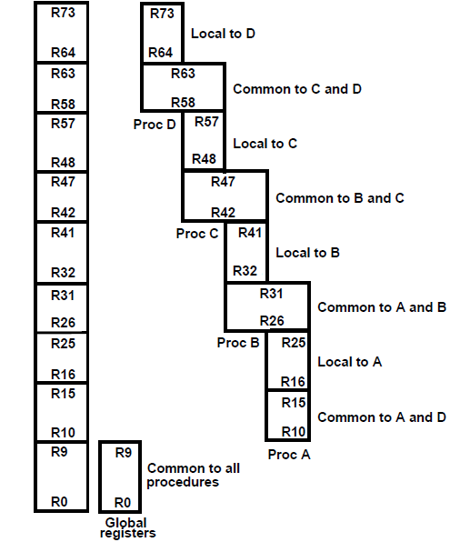
Overlapped Register
Windows Example 1
Overlapped Register Windows Example 1
As an example, suppose that procedure A calls procedure B. Registers R26 through R31 are common to both procedures, and therefore procedure A stores the parameters for procedure B in these registers. Procedure B uses local registers R32 through R41 for local variable storage. If procedure B calls procedure C, it will pass the parameters through registers R42 through R47. When procedure B is ready to return at the end of its computation, the program stores the results of the computation in registers R26 through R31 and transfers them back to the register window of procedure A.
Each procedure has available a total of 32 registers while it is active. This includes 10 global registers, 10 local registers, six low overlapping registers, and six high overlapping registers.
Notes:
Here's a more detailed exploration of overlapped register windows, focusing on their functioning, advantages, and real-world implications in CPU design.
Overlapped Register Windows: In-Depth Description
Overview
Overlapped register windows are a feature primarily found in RISC (Reduced Instruction Set Computer) architectures, designed to enhance the efficiency of method or procedure calls. They aim to minimize the overhead of saving and restoring registers when a function is invoked and returned from.
Detailed Functionality
Register Allocation:
When a procedure is called, instead of using the same set of registers used by the calling procedure, a new set (or window) of registers is allocated.
Each window consists of a defined number of registers that the current procedure can utilize without interference from other procedures.
Pointer Management:
A dedicated pointer (often called the window pointer) keeps track of the current active register window.
Incrementing the Pointer: When a new procedure is invoked, the pointer is incremented, transitioning to a new window. The new procedure has immediate access to its designated set of registers.
Decrementing the Pointer: When the procedure completes and a return statement is executed, the pointer is decremented, reactivating the previous register window.
Overlapping Mechanism:
Adjacent register windows share some registers, which facilitates the passing of parameters.
For instance, the last few registers of the previous window can be used by the new window, allowing parameters to be passed without requiring explicit memory operations or saving/restoring values.
Parameter Passing
Direct Access: Shared registers enable direct parameter passing between the calling and called procedures. Instead of pushing parameters to a stack in memory, the last few registers of a calling procedure can be accessed directly by the called procedure.
Return Values: Similarly, output values can be placed in the overlapping registers of the previous window, ensuring quick and efficient retrieval.
Advantages
Reduced Latency:
Eliminates the time-consuming operations associated with saving and restoring registers across calls, thus speeding up execution time for frequently invoked procedures.
Improved Performance:
The overlapping nature of the register windows reduces the need for memory access, which can be a bottleneck in performance. Register access is significantly faster than memory access.
Convenience in Function Calls:
Simplifies the function calling conventions, making it easier for compilers to generate optimized code, as parameters and return values can be managed efficiently.
Context Switching:
Facilitates quicker context switching, which is especially valuable in multi-threaded or multi-tasking environments where procedures are frequently called and returned.
Architectural Considerations
Modern RISC compilers and CPUs often leverage overlapped register windows to enhance the speed of function calls. This design can lead to substantial performance gains in applications with heavy computational workloads or recursive function calls.
Disadvantages to Consider
Complexity: The architecture becomes more complex as it requires additional hardware logic to manage the register windows.
Limited Registers: If too many nested procedure calls occur, the number of available registers may be exhausted, requiring a fallback to traditional stack-based parameter passing.
Real-World Examples
SPARC Architecture: One of the most notable examples of a processor architecture using overlapped register windows is the SPARC (Scalable Processor Architecture). SPARC processors implemented this feature to improve function call efficiency.
Advantages Observed: Systems utilizing this architecture often demonstrate improved throughput in scenarios involving high-frequency function calls, such as in scientific computations or real-time processing applications.
Summary
Overlapped register windows represent a significant strategy employed in RISC architectures to streamline procedure call handling. By managing groups of shared registers that actively reduce the need for saving and restoring values, this mechanism facilitates efficient processing, enhances performance, and simplifies parameter passing in function calls. While it introduces architectural complexity, the performance benefits can be substantial, particularly in compute-intensive or recursive applications.
If you have more specific aspects you'd like to delve into or if you have further questions, feel free to let me know!

Slide 21
Overlapped Register Windows
Other fixed-size register window schemes are possible, and each may differ in the size of the register window and the size of the total register file. In general, the organization of register windows has the following relationships:
  number of global registers = G
  number of local registers in each window = L
  number of registers common to two windows = C
  number of windows = W
Overlapped Register Windows
The number of registers available for each window (procedure) is calculated as follows:
  window size = L + 2C + G
The total number of registers needed in the processor is
  register file = (L + C) W + G
In the example: G = 10, L = 10, C = 6, W = 4.
  window size is 10 + 12 + 10 = 32 registers
  register file = (10 + 6) x 4 + 10 = 74 registers.

Slide 22
Registers
In Basic Computer, there is only one general purpose register, the Accumulator (AC)
In modern CPUs, there are many general-purpose registers
  Transfer between registers within the processor is relatively fast
  Going “off the processor” to access memory is much slower
How many registers will be the best ?
38
Design issues
Use completely general-purpose registers or specialize their use.
Specialized registers can generally be implicit in the opcode which type of register a certain operand specifier refers to, thus saving bits. On the other hand, this specialization limits the programmer’s flexibility.
Number of registers.
More registers require more operand specifier bits. Between 8 and 32 registers appear optimum. Fewer registers result in more memory references; more registers do not noticeably reduce memory references.
Registers length.
Registers that must hold addresses must be at least long enough to hold the largest address. Data registers should be able to hold values of most data types. Some machines allow two contiguous registers to be used as one for holding double-length values.
39

Slide 23
Stack Organization
40
Register Stack Organization
Stack
A very useful feature for nested subroutines, nested interrupt services.
Also efficient for arithmetic expression evaluation
Storage which can be accessed in Last In First Out (LIFO)
Pointer: SP (stack pointer)
Only PUSH and POP operations are applicable
A stack can exist as a stand-alone unit or can be implemented in the RAM memory attached to a CPU.
41
Notes:
Register Stack Organization
Register stack organization is an architectural approach that complements the traditional stack data structure with the use of registers. This method enhances the efficiency of subroutine calls, parameter passing, and returns, providing a more effective way to manage data during procedure execution.
Key Features
Stack Behavior:
The register stack functions similarly to a standard stack, utilizing Last In, First Out (LIFO) behavior. Each time a procedure is called, registers are pushed onto the stack, and they are popped off when returning from the procedure.
Procedure Calls and Returns:
Pushing Registers: When a subroutine is invoked, the current register values (from general-purpose registers) can be pushed onto the register stack.
Pop on Return: When the subroutine completes, these registers are popped from the stack, restoring the previous state.
Dedicated Hardware:
Typically, dedicated hardware manages the register stack, enabling fast push and pop operations without involving slower memory accesses.
Fixed or Variable Size:
The register stack can be organized with a fixed number of registers or allow for a variable number based on the needs of the executing procedures.
Advantages
Speed:
Operations involving registers are substantially faster than those involving main memory. Using a register stack eliminates the latency associated with memory access during procedure calls.
Reduced Overheads:
By managing register values directly in the stack, the need for saving and restoring these values in memory is minimized, reducing overall procedure call overhead.
Efficient Parameter Handling:
The register stack can effectively manage parameters to be passed to subordinate procedures, especially when multiple parameters need to be dealt with rapidly.
Applications
Embedded Systems: Often used in embedded systems where efficiency and speed are critical.
Real-Time Systems: Systems that require quick context switches benefit from register stack organization, as it allows for rapid access and restoration of execution contexts.
Recursive Functions: In recursive function calls, a register stack can efficiently handle multiple instances of registers required for each level of recursion without requiring excessive memory management.
Disadvantages
Limited Register Capacity:
The fixed size of the register stack can lead to overflow if too many subroutine calls occur (e.g., deep recursion), causing a need for fallbacks or error handling.
Complexity:
The register stack implementation adds complexity to the CPU architecture, requiring more sophisticated control logic to manage stack operations.
Architectural Dependency:
Different architectures may implement register stacks differently, making it less portable across systems.
Comparison with Traditional Stacks
FeatureRegister Stack OrganizationTraditional Stack (Memory-based)SpeedVery fast due to register access.Slower due to memory access delays.Ease of AccessO(1) access time for push/pop operations.O(n) access time based on stack location.CapacityLimited to the number of registers; may lead to overflow.Larger capacity, limited only by system memory.ManagementManaged through dedicated CPU hardware.Managed in software through memory operations.ApplicationSuitable for high-performance applications requiring quick context switches.General-purpose applications and larger data.
Summary
Register stack organization is a powerful architectural tool that leverages the speed of registers to manage subroutine calls and returns efficiently. By organizing registers in a stack-like structure, it facilitates faster data accessibility and reduces procedural overhead while also enabling effective parameter management. Although there are challenges related to capacity and complexity, the benefits often outweigh these issues in systems requiring high performance and responsiveness.
If you need further elaboration on specific aspects or want to explore examples, feel free to ask!

Slide 24
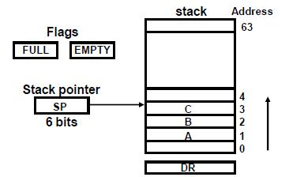
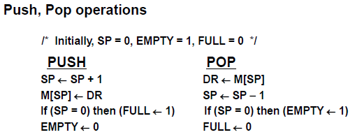
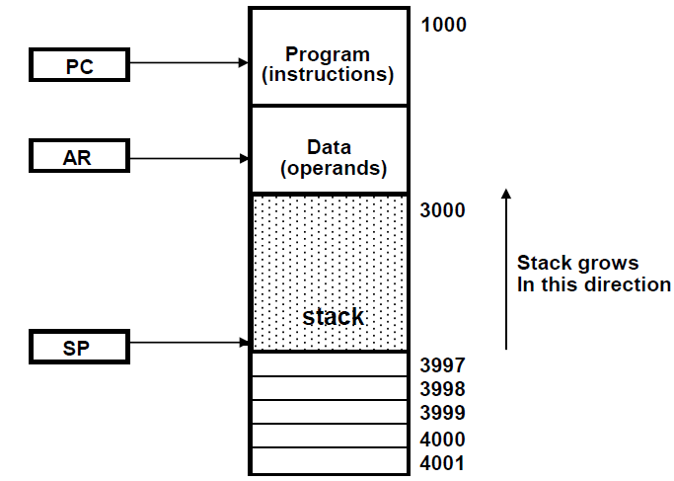
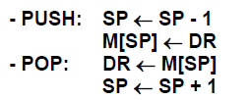
Register Stack Organization
42
Memory Stack Organization
A portion of memory is used as a stack with a processor register as a stack pointer
- Most computers don’t provide hardware to check overflow (full stack) or underflow (empty stack) → must be done in software.
43
20

Slide 25
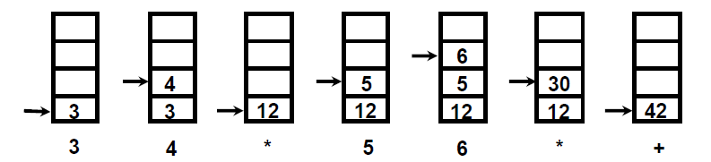
Evaluation of Arithmetic Expressions
Any arithmetic expression can be expressed in parenthesis-free Polish notation, including reverse Polish notation
  Put expression in reverse Polish (Postfix) notation
  Use PUSH and POP operations
    Number: push
    Operation: pop, pop, operation, then push result
44
Reverse Polish Notation
Arithmetic Expressions: A + B
A + B
▪ + A B
A B +
(Infix notation)
(Prefix or Polish notation)
(Postfix or reverse Polish notation)
The reverse Polish notation is very suitable for stack manipulation
45
21

Slide 26
Example
Write in postfix notation then write stack statements
(3 + 4) [10 (2 + 6) + 8]
Sol:
2 6 + 10 * 8 + 3 4 +*
or
3 4 + 2 6 + 10 * 8 + *
46
Example (3 + 4) [10 (2 + 6) + 8]
Stack organization CPU:
Push 2
Push 6 Add Push 10 Mul Push 8 Add Push 3
Push 4 Add Mul
47
22

